Slide 1
A moving dot hologram in a 3-by-3 square lattice
Notes:
integration

Slide 2
A moving dot hologram
Sample plane phase
Recovered image
Imaginary gauge field implementation

Slide 3


A moving dot hologram by Gaussian dots
Near Field
$$200μm$$
$$z=1000μm$$

Slide 4
Microring lasers

Slide 5
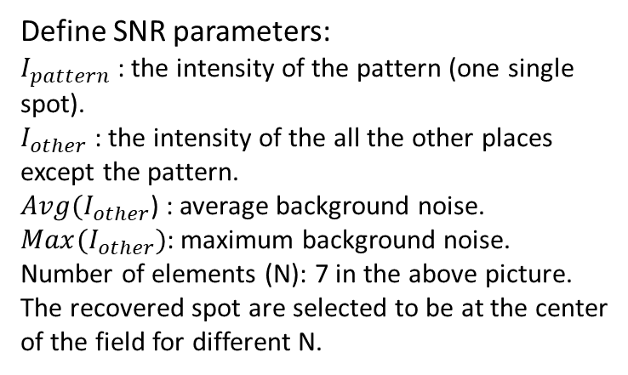


Improving Image Quality
Spacing = 50µm;
z = 200µm;
SNR1
SNR2
Define SNR parameters:
$I_{pattern}$ : the intensity of the pattern (one single spot).
$I_{other}$ : the intensity of the all the other places except the pattern.
$Avg(I_{other}$) : average background noise.
$Max(I_{other})$: maximum background noise.
Number of elements (N): 7 in the above picture.
The recovered spot are selected to be at the center of the field for different N.
Number of elements
Number of elements
$${SNR}_{1}=\frac{I_{pattern}}{Avg(I_{other})}$$
$${SNR}_{2}=\frac{I_{pattern}}{Max(I_{other})}$$
As the number of elements increase, the SNR of recovered image also enhances.

Slide 6
Why the number of elements matters
N=7
N=21
With more number of elements, the sample plane has more pixels to depict the near field pattern (which looks more continuous)

